Slide 1
Lecture
Basics of Accounting
1
L.O. 1-1: Accounting activities and users
L.O. 1-2: The building blocks of accounting
L.O. 1-3: The accounting equation
L.O. 1-4: Analyzing business transactions
L.O. 1-5: The financial statements

Slide 2
Learning Objective 1-1
Accounting Activities and Users

Slide 3
Outline
Three activities
Who uses accounting data?
Financial and managerial accounting

Slide 4
Three Activities
Accounting consists of three basic activities – it
identifies,
records, and
communicates
the economic events of an organization to interested users.

Slide 5
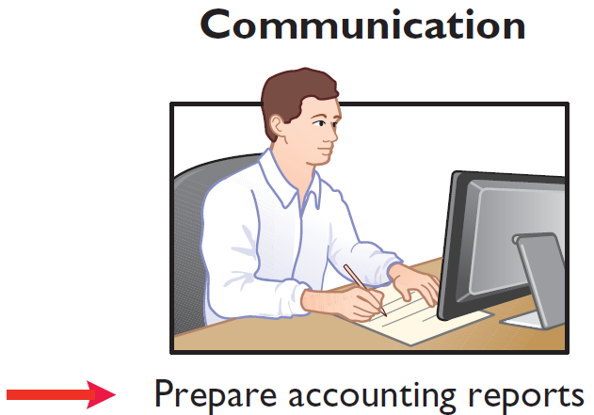
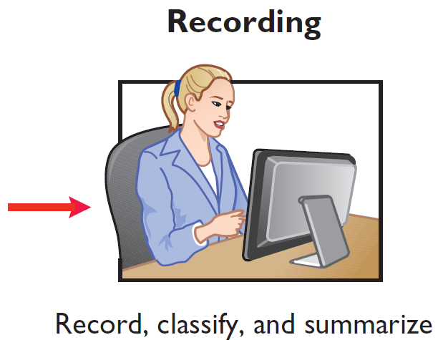
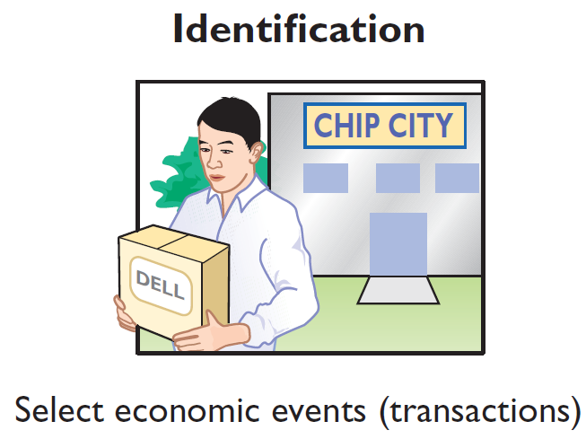
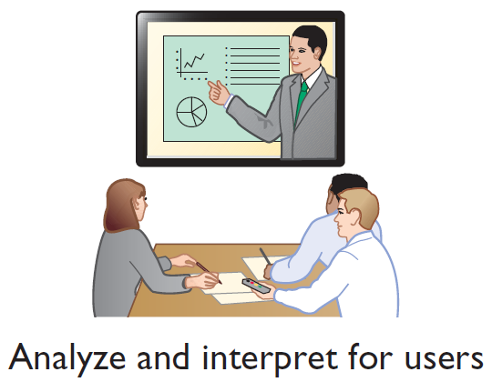
Three Activities
The accounting process includes
the bookkeeping function.

Slide 6
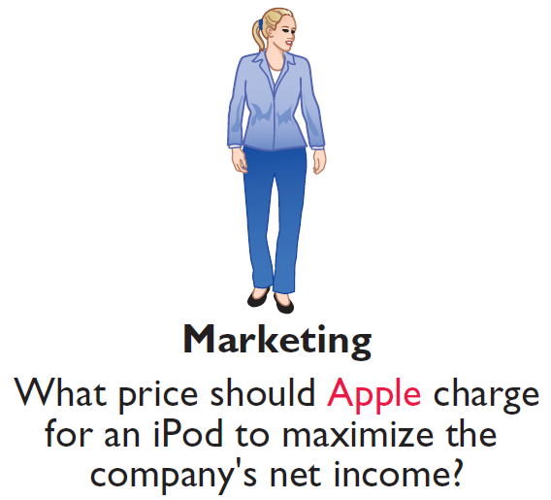
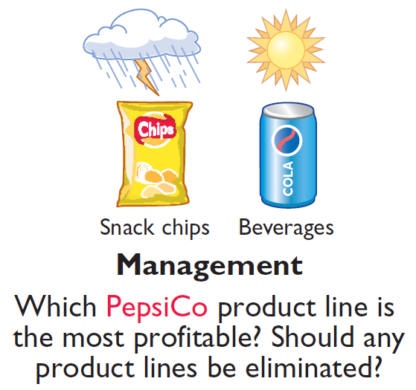
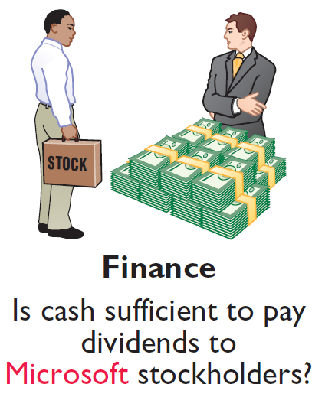

Who Uses Accounting Data?
INTERNAL USERS

Slide 7
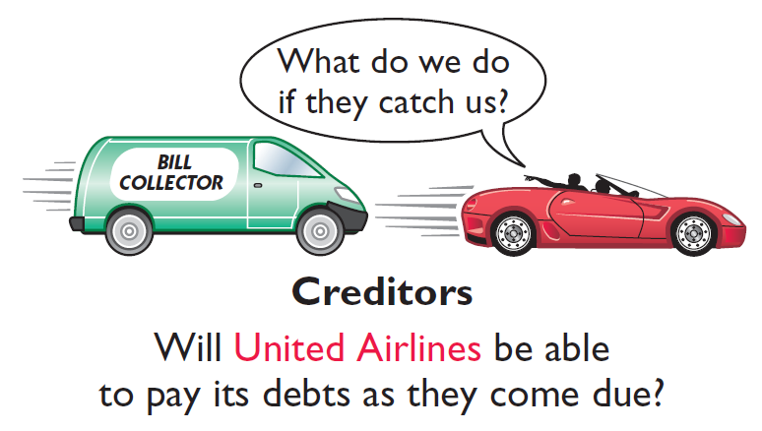

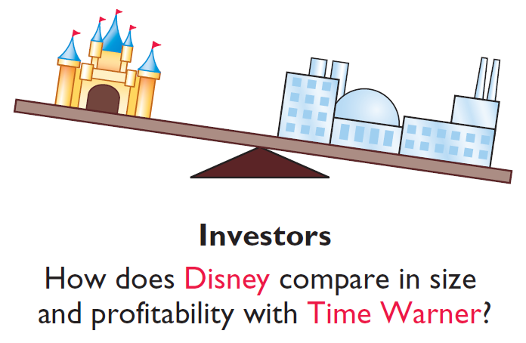
Who Uses Accounting Data?
EXTERNAL USERS

Slide 8
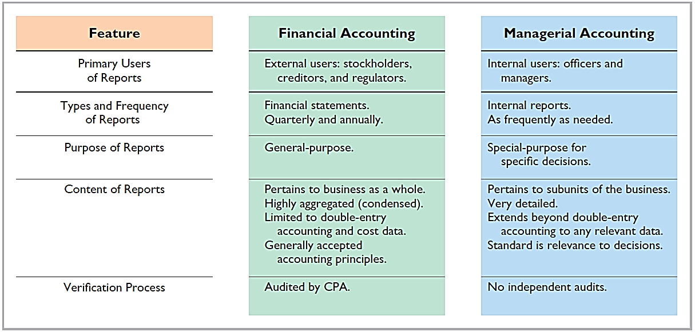
Financial and Managerial Accounting

Slide 9
Do It 1: Basic Concepts
Indicate whether the following statements are true or false.
The three steps in the accounting process are identification, recording, and communication.
Bookkeeping encompasses all steps in the accounting process.
Accountants prepare, but do not interpret, financial reports.
The two most common types of external users are investors and company officers.
Managerial accounting activities focus on reports for internal users.
Solution:
1. True
2. False
3. False
4. False
5. True

Slide 10
Learning Objective 1-2
The Building Blocks of Accounting

Slide 11
Outline
Ethics
Generally Accepted Accounting Principles (GAAP)
Measurement principles
Assumptions

Slide 12
Ethics
Recent financial scandals include: Enron, WorldCom, HealthSouth, AIG, and other companies.
Regulators and lawmakers concerned that economy would suffer if investors lost confidence in corporate accounting. In response,
Congress passed Sarbanes-Oxley Act (SOX).
Effective financial reporting depends on sound ethical behavior.

Slide 13
Generally Accepted Accounting Principles
Financial Statements
Balance Sheet
Income Statement
Statement of Stockholders’ Equity
Statement of Cash Flows
Note Disclosure
Various users need financial information
The accounting profession has developed standards that are generally accepted and universally practiced.
Generally Accepted Accounting Principles (GAAP)

Slide 14
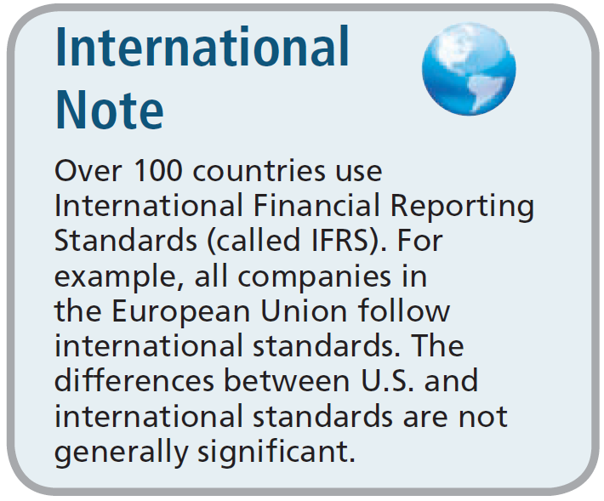
Generally Accepted Accounting Principles
Generally Accepted Accounting Principles (GAAP) – Standards that are generally accepted and universally practiced. These standards indicate how to report economic events.
Standard-setting bodies:
Financial Accounting Standards Board (FASB)
Securities and Exchange Commission (SEC)
International Accounting Standards Board (IASB)

Slide 15
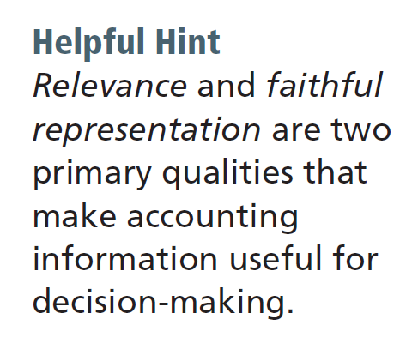
Measurement Principles
HISTORICAL COST PRINCIPLE (or cost principle) dictates that companies record assets at their cost.
FAIR VALUE PRINCIPLE states that assets and liabilities should be reported at fair value (the price received to sell an asset or settle a liability).
Selection of which principle to follow generally relates to trade-offs between relevance and faithful representation.

Slide 16
Assumptions
MONETARY UNIT ASSUMPTION requires that companies include in the accounting records only transaction data that can be expressed in terms of money.
ECONOMIC ENTITY ASSUMPTION requires that activities of the entity be kept separate and distinct from the activities of its owner and all other economic entities.
Proprietorship
Partnership
Corporation
Forms of Business Ownership

Slide 17
Forms of Business Ownership
Proprietorship
Partnership
Corporation
Owned by one person
Owner is often manager/operator
Owner receives any profits, suffers any losses, and is personally liable for all debts
Owned by two or more persons
Often retail and service-type businesses
Generally unlimited personal liability
Partnership agreement
Ownership divided into shares of stock
Separate legal entity organized under state corporation law
Limited liability

Slide 18
Assumptions
Question
Combining the activities of Kellogg and General Mills would violate the
cost principle.
economic entity assumption.
monetary unit assumption.
ethics principle.

Slide 19
Assumptions
Question
A business organized as a separate legal entity under state law having ownership divided into shares of stock is a
proprietorship.
partnership.
corporation.
sole proprietorship.

Slide 20
Learning Objective 1-3
The Accounting Equation

Slide 21
Outline
Basic accounting equation
Stockholder’s equity

Slide 22
Basic Accounting Equation
Assets
Liabilities
Stockholder’s Equity
=
+
Basic Accounting Equation
Provides the underlying framework for recording and summarizing economic events.
Assets must equal the sum of liabilities and stockholders’ equity.
If a business is liquidated, claims of creditors (liabilities) must be paid before ownership claims (stockholders’ equity).

Slide 23
Basic Accounting Equation
Assets
Liabilities
Stockholder’s Equity
=
+
Assets
Resources a business owns.
Provide future services or benefits.
Cash, Supplies, Equipment, etc.

Slide 24
Basic Accounting Equation
Assets
Liabilities
Stockholder’s Equity
=
+
Liabilities
Claims against assets (debts and obligations).
Creditors (party to whom money is owed).
Accounts Payable, Notes Payable, Salaries and Wages Payable, etc.

Slide 25
Basic Accounting Equation
Assets
Liabilities
Stockholder’s Equity
=
+
Stockholders’ Equity
Ownership claim on total assets.
Referred to as residual equity.
Common stock and retained earnings.

Slide 26
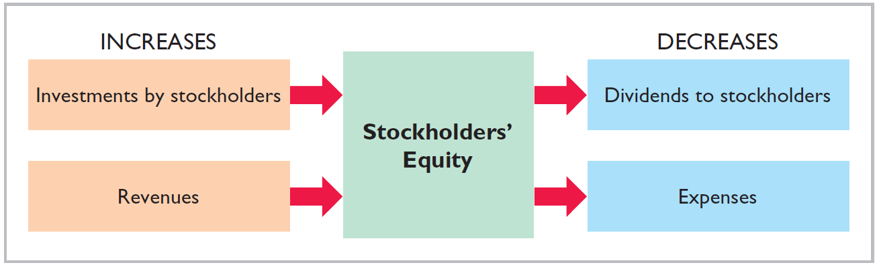
Stockholders’ Equity
Investments by stockholders represent the total amount paid in by stockholders for the shares they purchase.

Slide 27
Stockholders’ Equity
Revenues result from business activities entered into for the purpose of earning income.
Common sources of revenue are: sales, fees, services, commissions, interest, dividends, royalties, and rent.

Slide 28
Stockholders’ Equity
Dividends are the distribution of cash or other assets to stockholders.
Dividends reduce retained earnings. However, dividends are not an expense.

Slide 29
Stockholders’ Equity
Expenses are the cost of assets consumed or services used in the process of earning revenue.
Common expenses are: salaries expense, rent expense, utilities expense, tax expense, etc.

Slide 30

Stockholders’ Equity Effects
Classify the following items as issuance of stock, dividends, revenues, or expenses. Then indicate whether each item increases or decreases stockholders’ equity.
Classification
Effect on Equity
Rent Expense
Service Revenue
Dividends
Salaries and Wages Expense
Expense
Decrease
Revenue
Increase
Dividends
Decrease
Expense
Decrease

Slide 31
Learning Objective 1-4
Analyzing Business Transactions

Slide 32
Outline
Transaction analysis
Expanding the accounting equation
Summary of transactions

Slide 33
Transaction Analysis
Transactions are a business’s economic events recorded by accountants.
May be external or internal.
Not all activities represent transactions.
Each transaction has a dual effect on the accounting equation.

Slide 34
The Accounting Cycle
1. Analyze business transactions
9. Prepare a post-closing trial balance
2. Journalize the transactions
8. Journalize and post closing entries
3. Post to ledger accounts
7. Prepare financial statements
4. Prepare a trial balance
6. Prepare an adjusted trial balance
5. Journalize and post adjusting entries

Slide 35


Transaction Analysis
Illustration: Are the following events recorded in the accounting records?
Discuss product design with potential customer
Purchase computer
Event
Pay rent
Criterion
Is the financial position (assets, liabilities, or stockholder’s equity) of the company changed?
Record/
Don’t Record

Slide 36
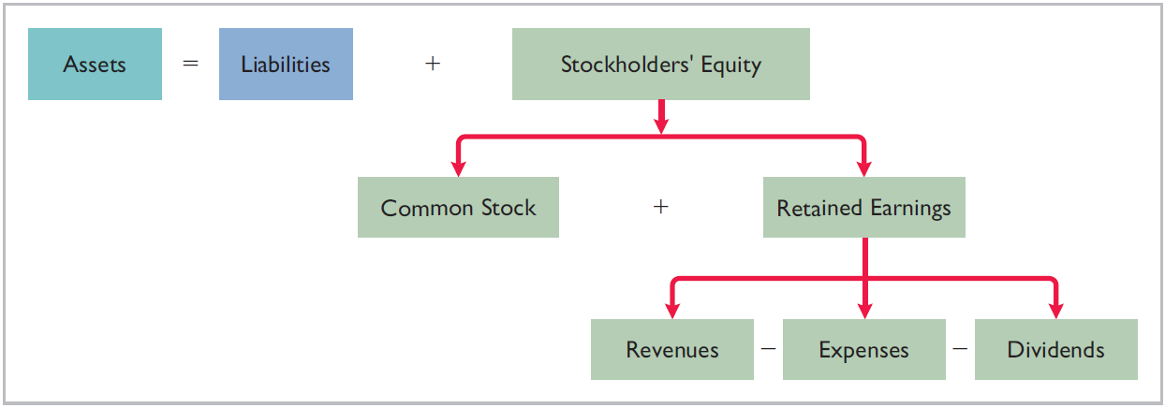
Expanding the accounting equation
How do business transactions affect the accounting equation?

Slide 37
Transaction Analysis
TRANSACTION 1. INVESTMENT BY STOCKHOLDERS Ray and Barbara Neal decide to start a smartphone app development company that they incorporate as Softbyte Inc. On September 1, 2017, they invest $15,000 cash in the business in exchange for $15,000 of common stock. The common stock indicates the ownership interest that the Neals have in Softbyte Inc. This transaction results in an equal increase in both assets and stockholders’ equity.
Illustration 1-9
Assets = Liabilities + Stockholders’ Equity
Trans-
action
Cash
+
Accounts
Receivable
+
Supplies
+
Equipment
=
Accounts
Payable
+
Common Stock
Retained Earnings
Rev. – Exp. – Div.
+
1. +15,000 +15,000

Slide 38
TRANSACTION 2. PURCHASE OF EQUIPMENT FOR CASH Softbyte Inc. purchases computer equipment for $7,000 cash.
Illustration 1-9
Assets = Liabilities + Stockholders’ Equity
Trans-
action
Cash
+
Accounts
Receivable
+
Supplies
+
Equipment
=
Accounts
Payable
+
Common Stock
Retained Earnings
Rev. – Exp. – Div.
+
1. +15,000 +15,000
2. -7,000 +7,000
3. +1,600 +1,600
4. +1,200 +1,200
5. +250 -250
6. +1,500 +2,000 +3,500
7. -1,700 -600
-900
-200
8. -250 -250
9. +600 -600
10. -1,300 -1,300
+
+
+
=
+
+
-
-
$8,050 $1,400 $1,600 $7,000 $1,600 $15,000 $4,700 $1,950 $1,300

Slide 39
TRANSACTION 3. PURCHASE OF SUPPLIES ON CREDIT Softbyte Inc. purchases for $1,600 headsets and other accessories expected to last several months. The supplier allows Softbyte to pay this bill in October.
Illustration 1-9
Assets = Liabilities + Stockholders’ Equity
Trans-
action
Cash
+
Accounts
Receivable
+
Supplies
+
Equipment
=
Accounts
Payable
+
Common Stock
Retained Earnings
Rev. – Exp. – Div.
+
1. +15,000 +15,000
2. -7,000 +7,000
3. +1,600 +1,600
4. +1,200 +1,200
5. +250 -250
6. +1,500 +2,000 +3,500
7. -1,700 -600
-900
-200
8. -250 -250
9. +600 -600
10. -1,300 -1,300
+
+
+
=
+
+
-
-
$8,050 $1,400 $1,600 $7,000 $1,600 $15,000 $4,700 $1,950 $1,300

Slide 40
TRANSACTION 4. SERVICES PERFORMED FOR CASH Softbyte Inc. receives $1,200 cash from customers for app development services it has performed.
Illustration 1-9
Assets = Liabilities + Stockholders’ Equity
Trans-
action
Cash
+
Accounts
Receivable
+
Supplies
+
Equipment
=
Accounts
Payable
+
Common Stock
Retained Earnings
Rev. – Exp. – Div.
+
1. +15,000 +15,000
2. -7,000 +7,000
3. +1,600 +1,600
4. +1,200 +1,200
5. +250 -250
6. +1,500 +2,000 +3,500
7. -1,700 -600
-900
-200
8. -250 -250
9. +600 -600
10. -1,300 -1,300
+
+
+
=
+
+
-
-
$8,050 $1,400 $1,600 $7,000 $1,600 $15,000 $4,700 $1,950 $1,300

Slide 41
TRANSACTION 5. PURCHASE OF ADVERTISING ON CREDIT Softbyte Inc. receives a bill for $250 from the Daily News for advertising on its online website but postpones payment until a later date.
Illustration 1-9
Assets = Liabilities + Stockholders’ Equity
Trans-
action
Cash
+
Accounts
Receivable
+
Supplies
+
Equipment
=
Accounts
Payable
+
Common Stock
Retained Earnings
Rev. – Exp. – Div.
+
1. +15,000 +15,000
2. -7,000 +7,000
3. +1,600 +1,600
4. +1,200 +1,200
5. +250 -250
6. +1,500 +2,000 +3,500
7. -1,700 -600
-900
-200
8. -250 -250
9. +600 -600
10. -1,300 -1,300
+
+
+
=
+
+
-
-
$8,050 $1,400 $1,600 $7,000 $1,600 $15,000 $4,700 $1,950 $1,300

Slide 42
TRANSACTION 6. SERVICES PROVIDED FOR CASH AND CREDIT. Softbyte provides $3,500 of services. The company receives cash of $1,500 from customers, and it bills the balance of $2,000 on account.
Illustration 1-9
Assets = Liabilities + Stockholders’ Equity
Trans-
action
Cash
+
Accounts
Receivable
+
Supplies
+
Equipment
=
Accounts
Payable
+
Common Stock
Retained Earnings
Rev. – Exp. – Div.
+
1. +15,000 +15,000
2. -7,000 +7,000
3. +1,600 +1,600
4. +1,200 +1,200
5. +250 -250
6. +1,500 +2,000 +3,500
7. -1,700 -600
-900
-200
8. -250 -250
9. +600 -600
10. -1,300 -1,300
+
+
+
=
+
+
-
-
$8,050 $1,400 $1,600 $7,000 $1,600 $15,000 $4,700 $1,950 $1,300

Slide 43
TRANSACTION 7. PAYMENT OF EXPENSES Softbyte Inc. pays the following expenses in cash for September: office rent $600, salaries and wages of employees $900, and utilities $200.
Illustration 1-9
Assets = Liabilities + Stockholders’ Equity
Trans-
action
Cash
+
Accounts
Receivable
+
Supplies
+
Equipment
=
Accounts
Payable
+
Common Stock
Retained Earnings
Rev. – Exp. – Div.
+
1. +15,000 +15,000
2. -7,000 +7,000
3. +1,600 +1,600
4. +1,200 +1,200
5. +250 -250
6. +1,500 +2,000 +3,500
7. -1,700 -600
-900
-200
8. -250 -250
9. +600 -600
10. -1,300 -1,300
+
+
+
=
+
+
-
-
$8,050 $1,400 $1,600 $7,000 $1,600 $15,000 $4,700 $1,950 $1,300

Slide 44
TRANSACTION 8. PAYMENT OF ACCOUNTS PAYABLE Softbyte Inc. pays its $250 Daily News bill in cash. The company previously (in Transaction 5) recorded the bill as an increase in Accounts Payable.
Illustration 1-9
Assets = Liabilities + Stockholders’ Equity
Trans-
action
Cash
+
Accounts
Receivable
+
Supplies
+
Equipment
=
Accounts
Payable
+
Common Stock
Retained Earnings
Rev. – Exp. – Div.
+
1. +15,000 +15,000
2. -7,000 +7,000
3. +1,600 +1,600
4. +1,200 +1,200
5. +250 -250
6. +1,500 +2,000 +3,500
7. -1,700 -600
-900
-200
8. -250 -250
9. +600 -600
10. -1,300 -1,300
+
+
+
=
+
+
-
-
$8,050 $1,400 $1,600 $7,000 $1,600 $15,000 $4,700 $1,950 $1,300

Slide 45
TRANSACTION 9. RECEIPT OF CASH ON ACCOUNT Softbyte Inc. receives $600 in cash from customers who had been billed for services (in Transaction 6).
Illustration 1-9
Assets = Liabilities + Stockholders’ Equity
Trans-
action
Cash
+
Accounts
Receivable
+
Supplies
+
Equipment
=
Accounts
Payable
+
Common Stock
Retained Earnings
Rev. – Exp. – Div.
+
1. +15,000 +15,000
2. -7,000 +7,000
3. +1,600 +1,600
4. +1,200 +1,200
5. +250 -250
6. +1,500 +2,000 +3,500
7. -1,700 -600
-900
-200
8. -250 -250
9. +600 -600
10. -1,300 -1,300
+
+
+
=
+
+
-
-
$8,050 $1,400 $1,600 $7,000 $1,600 $15,000 $4,700 $1,950 $1,300

Slide 46
TRANSACTION 10. DIVIDENDS The corporation pays a dividend of $1,300 in cash to Ray and Barbara Neal, the stockholders of Softbyte Inc.
Illustration 1-9
Assets = Liabilities + Stockholders’ Equity
Trans-
action
Cash
+
Accounts
Receivable
+
Supplies
+
Equipment
=
Accounts
Payable
+
Common Stock
Retained Earnings
Rev. – Exp. – Div.
+
1. +15,000 +15,000
2. -7,000 +7,000
3. +1,600 +1,600
4. +1,200 +1,200
5. +250 -250
6. +1,500 +2,000 +3,500
7. -1,700 -600
-900
-200
8. -250 -250
9. +600 -600
10. -1,300 -1,300
+
+
+
=
+
+
-
-
$8,050 $1,400 $1,600 $7,000 $1,600 $15,000 $4,700 $1,950 $1,300
$18,050
$18,050

Slide 47
Tabular Analysis
Transactions made by Virmari & Co., a public accounting firm, for the month of August are shown below. Prepare a tabular analysis which shows the effects of these transactions on the expanded accounting equation.
Stockholders purchased shares of stock for $25,000 cash.
The company purchased $7,000 of office equipment on credit.
The company received $8,000 cash in exchange for services performed.
The company paid $850 for this month’s rent.
The company paid a dividend of $1,000 in cash to stockholders.

Slide 48
Tabular Analysis
Stockholders purchased shares of stock for $25,000 cash.
Assets = Liabilities + Stockholders’ Equity
Trans-
action
Cash
+
Equipment
=
Accounts
Payable
+
Common Stock
+
Retained Earnings
Rev. – Exp. – Div.
1. +25,000 +25,000
2. +7,000 +7,000
3. +8,000 +8,000
4. -850 -850
5. -1,000 -1,000
+
=
+
+
-
-
$31,150 $7,000 $7,000 $25,000 $8,000 $850 $1,000
$18,050
$18,050

Slide 49
Tabular Analysis
The company purchased $7,000 of office equipment on credit.
Assets = Liabilities + Stockholders’ Equity
Trans-
action
Cash
+
Equipment
=
Accounts
Payable
+
Common Stock
+
Retained Earnings
Rev. – Exp. – Div.
1. +25,000 +25,000
2. +7,000 +7,000
3. +8,000 +8,000
4. -850 -850
5. -1,000 -1,000
+
=
+
+
-
-
$31,150 $7,000 $7,000 $25,000 $8,000 $850 $1,000
$18,050
$18,050

Slide 50
Tabular Analysis
The company received $8,000 cash in exchange for services performed.
Assets = Liabilities + Stockholders’ Equity
Trans-
action
Cash
+
Equipment
=
Accounts
Payable
+
Common Stock
+
Retained Earnings
Rev. – Exp. – Div.
1. +25,000 +25,000
2. +7,000 +7,000
3. +8,000 +8,000
4. -850 -850
5. -1,000 -1,000
+
=
+
+
-
-
$31,150 $7,000 $7,000 $25,000 $8,000 $850 $1,000
$18,050
$18,050

Slide 51
Tabular Analysis
The company paid $850 for this month’s rent.
Assets = Liabilities + Stockholders’ Equity
Trans-
action
Cash
+
Equipment
=
Accounts
Payable
+
Common Stock
+
Retained Earnings
Rev. – Exp. – Div.
1. +25,000 +25,000
2. +7,000 +7,000
3. +8,000 +8,000
4. -850 -850
5. -1,000 -1,000
+
=
+
+
-
-
$31,150 $7,000 $7,000 $25,000 $8,000 $850 $1,000
$18,050
$18,050

Slide 52
Tabular Analysis
The company paid a dividend of $1,000 in cash to stockholders.
Assets = Liabilities + Stockholders’ Equity
Trans-
action
Cash
+
Equipment
=
Accounts
Payable
+
Common Stock
+
Retained Earnings
Rev. – Exp. – Div.
1. +25,000 +25,000
2. +7,000 +7,000
3. +8,000 +8,000
4. -850 -850
5. -1,000 -1,000
+
=
+
+
-
-
$31,150 $7,000 $7,000 $25,000 $8,000 $850 $1,000
$38,150
$38,150

Slide 53
Summary of Transactions
Each transaction must be analyzed in terms of its effect on:
The three components of the basic accounting equation.
Specific types (kinds) of items within each component.
The two sides of the equation must always be equal.
The Common Stock and Retained Earnings columns indicate the causes of each change in the stockholders’ claim on assets.

Slide 54
Learning Objective 1-5
The Financial Statements

Slide 55
Outline
Income statement
Statement of retained earnings
Balance sheet
Statement of cash flows

Slide 56
Financial Statements
Companies prepare four financial statements :
Income Statement
Retained Earnings Statement
Balance Sheet
Statement of Cash Flows
Data Flow

Slide 57
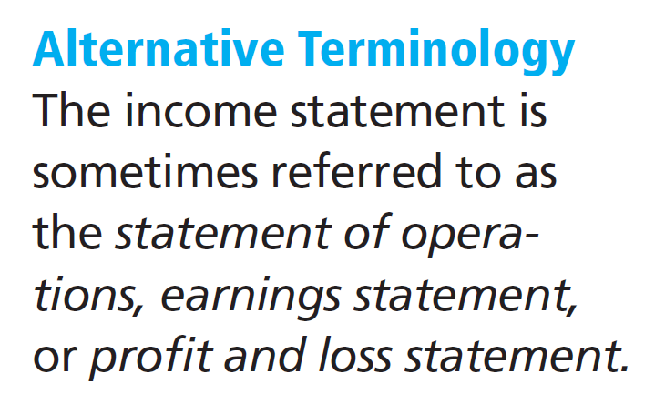
Income Statement
Reports the profitability of the company’s operations over a specific period of time.
Lists revenues first, followed by expenses.
Shows net income (or net loss).
Does not include investment and dividend transactions between the stockholders and the business

Slide 58
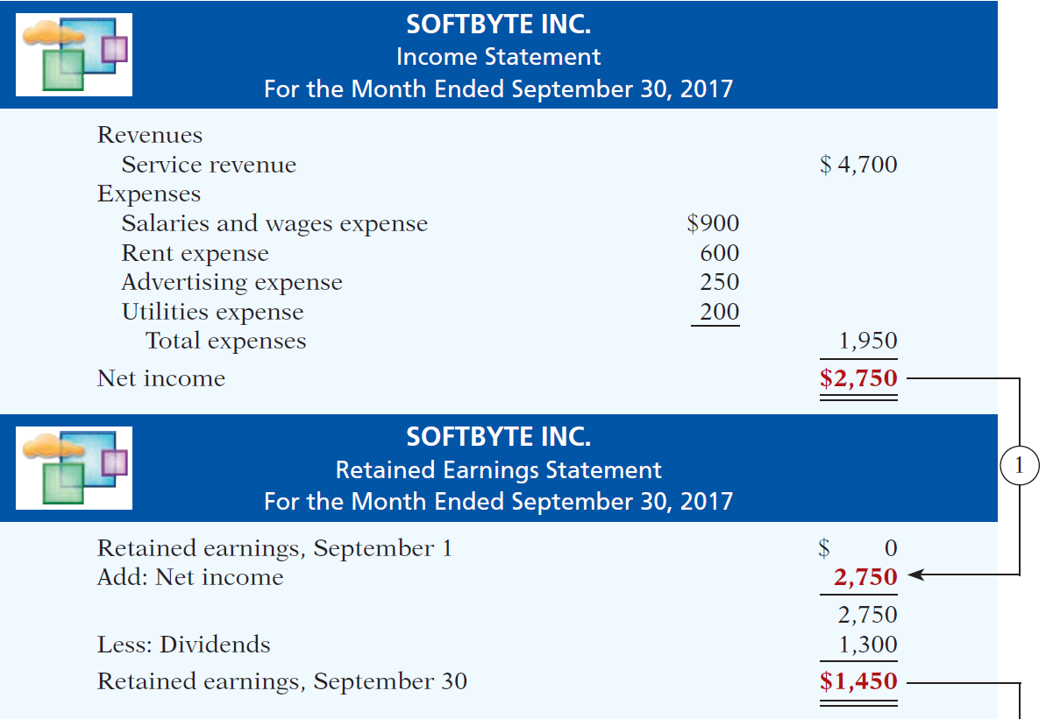
Net income is needed to determine the ending balance in retained earnings.
Financial Statements

Slide 59
Retained Earnings Statement
Reports the changes in retained earnings for a specific period of time.
The time period is the same as that covered by the income statement.
Information provided indicates the reasons why retained earnings increased or decreased during the period.

Slide 60
Balance Sheet
Reports the assets, liabilities, and stockholders’ equity at a specific date.
Lists assets at the top, followed by liabilities and stockholder’s equity.
Total assets must equal total liabilities and stockholder’s equity.
Is a snapshot of the company’s financial condition at a specific moment in time (usually the month-end or year-end).

Slide 61
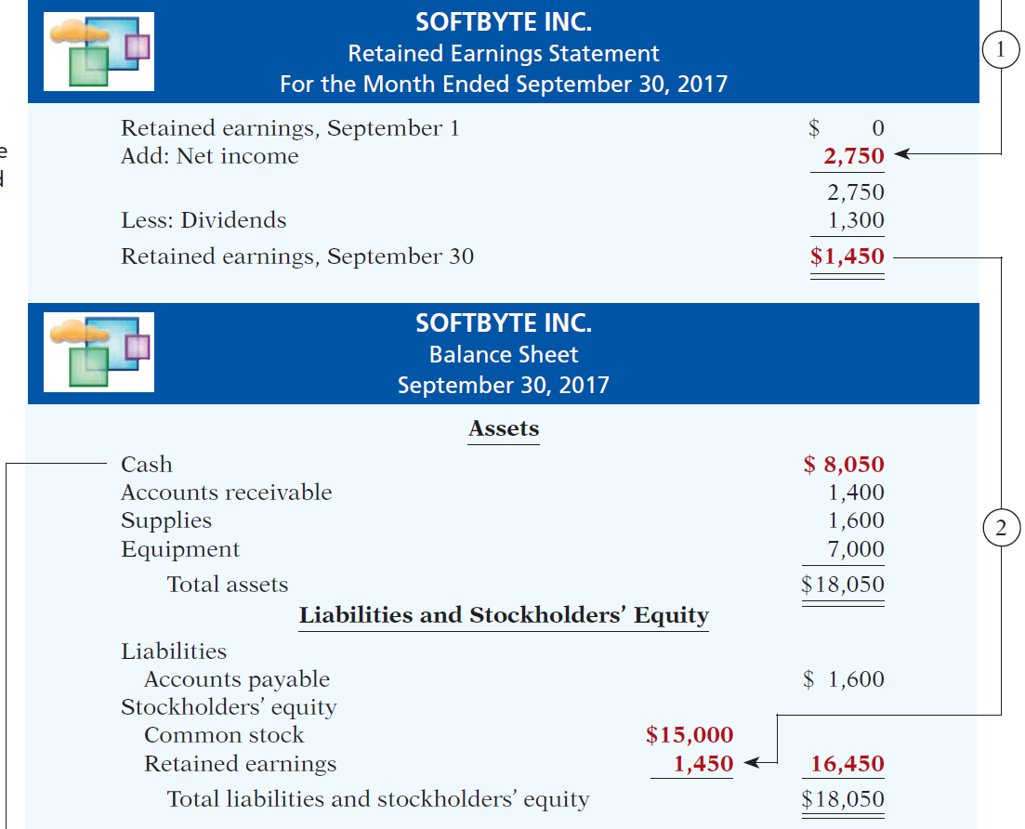
The ending balance in retained earnings is needed in preparing the balance sheet.
Financial Statements

Slide 62
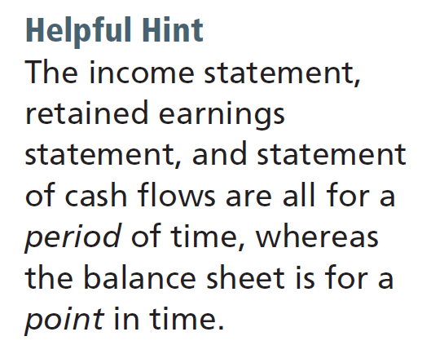
Statement of Cash Flows
Information on the cash receipts and payments for a specific period of time.
Answers the following:
Where did cash come from?
What was cash used for?
What was the change in the
cash balance?

Slide 63
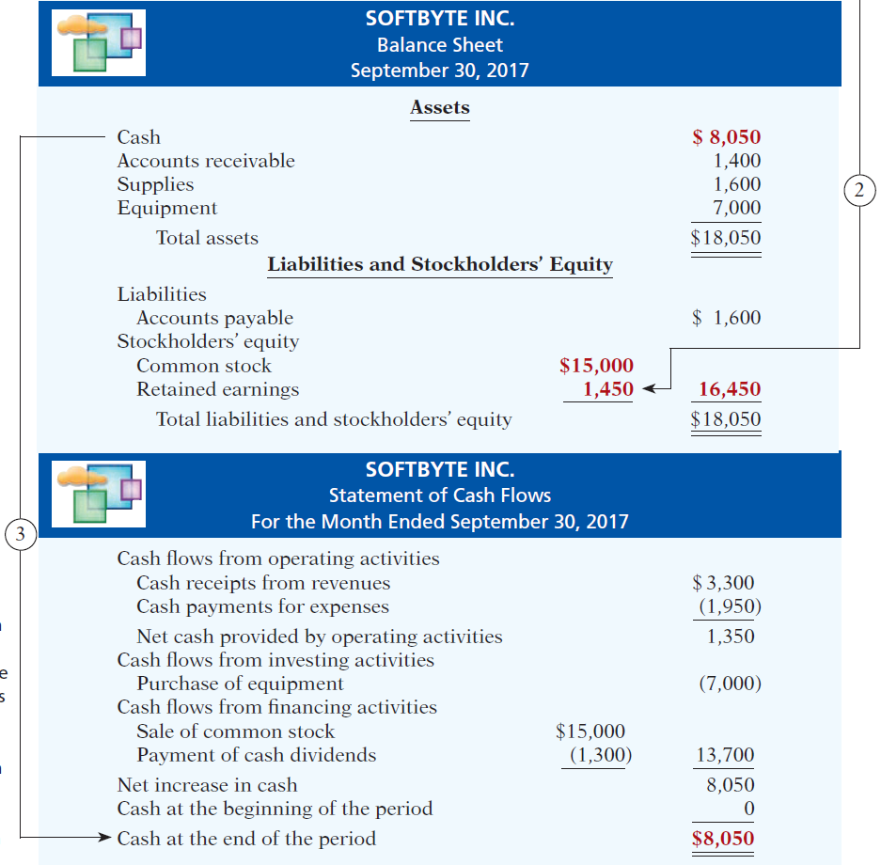
Financial Statements
Balance sheet and income statement are needed to prepare statement of cash flows.
Illustration 1-10

Slide 64
Financial Statements
Question
Net income will result during a time period when:
assets exceed liabilities.
assets exceed revenues.
expenses exceed revenues.
revenues exceed expenses.

Slide 65
Financial Statements
Question
Which of the following financial statements is prepared as of a specific date?
Balance sheet.
Income statement.
Retained earnings statement.
Statement of cash flows.

